Slide 1
Absorbable barriers the future or just a trend ?
Marc LEPERE M. D.
BARD EUROPEAN SYMPOSIUM
PRAGUE SEPT 23 20011

Slide 2
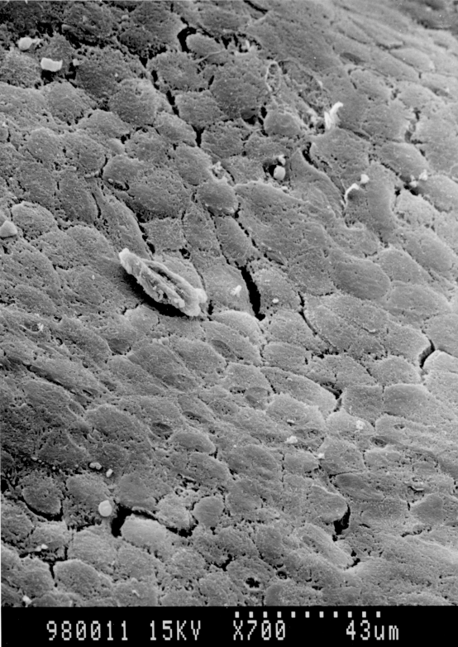
How does it work?
Mesothelial healing quick and effective
Neoperitonisation : 3 days !!!

Slide 3
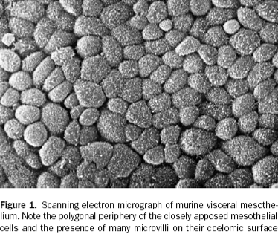
Coming from the margins growing up side to side

Slide 4
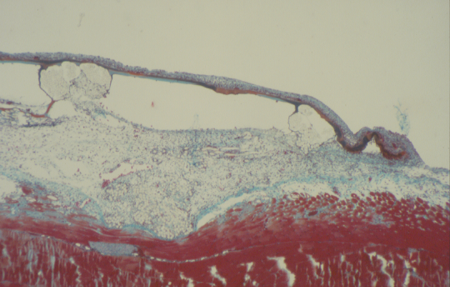
Complete « carpet » at day7

Slide 5
Peritoneal adhesions
Useful
  Omentum
  Bringing mesothelium
  Bridging uncovered areas
Harmful
  If responsible of digestive fixity
  But: Two layers of mesothelium do not stick if they are in motion
  Laparosocopy : less bowel ileus
  Bowel obstruction : foreign body macrophagic reaction

Slide 6


Slide 7
Barriers : resorbable vs permanent
Hydro ( lipo) phylic vs hydrophobic
Less surface of adhesions
Lower rate of late septis
Allows use of macroporous mesh on the parietal side
Therefore less shrinkage

Slide 8
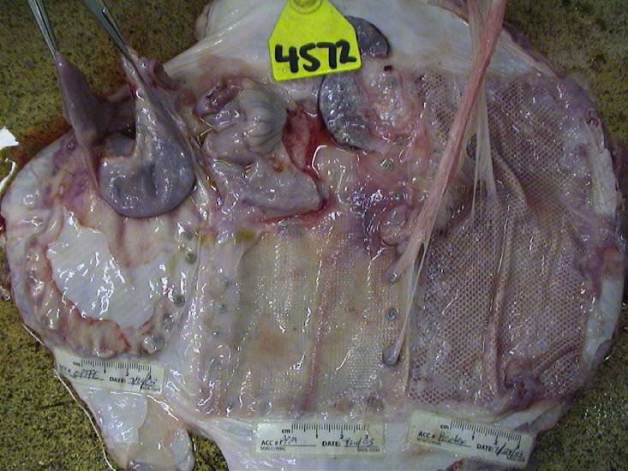
Animal models
ePTFE
Tacks
PCO
PPM

Slide 9
Available absorbable materials
Collagen
Hyaluronic acid
Oxidized cellulose
Lipidic film
Glycolic polymer ( poliglecaprone)
Various cinetic features of resorbtion

Slide 10
Human use
Witness series
  Efficacy, easyness to dissect, low rate of severe complication( fistula)
Marketing datas
Revenue in Millions

Slide 11
Messages
It works
Fit for large meshes
Long term follow up : ok
Restores the histological genuine structure
Widely accepted by surgical community

