Slide 1


IS THERE A NEED FOR FULLY ABSORBABLE MESH FOR INGUINAL HERNIA REPAIR ?
JP FAURE MD. PhD.
Department of Visceral and Digestive Surgery,
University Hospital of Poitiers, France.

Slide 2
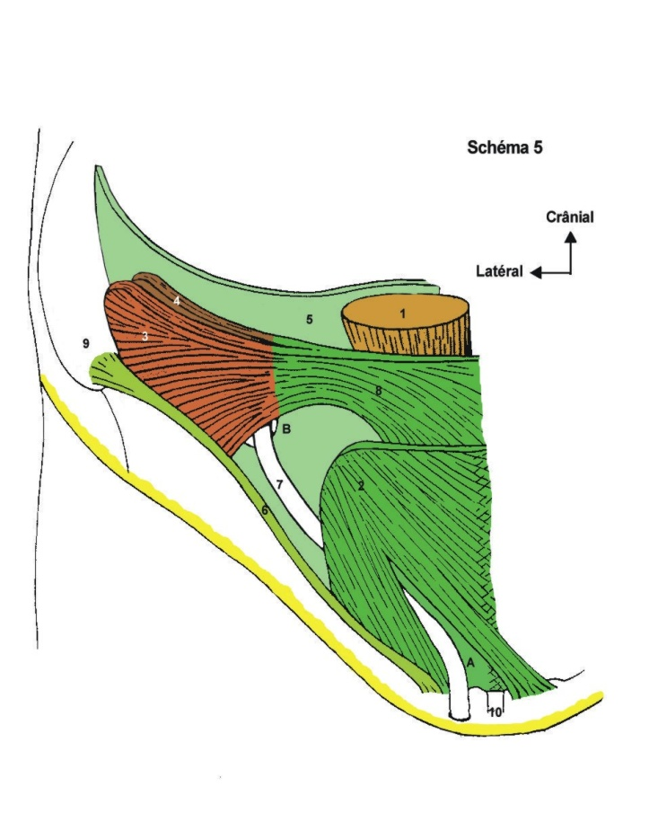
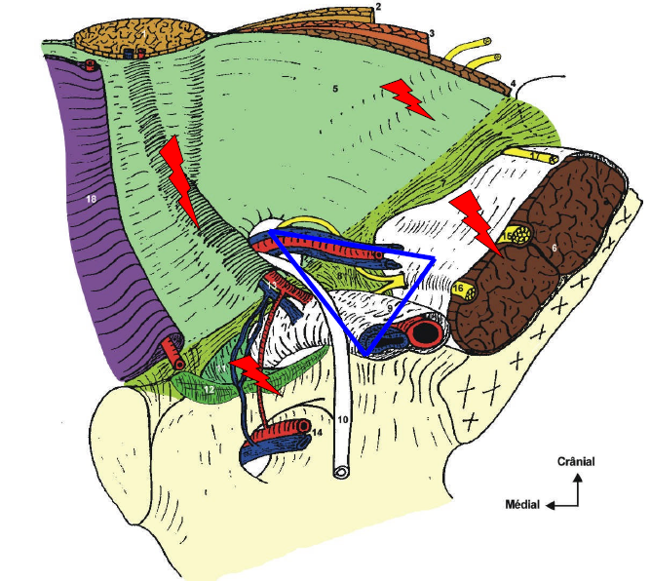
ANATOMY

Slide 3

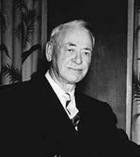
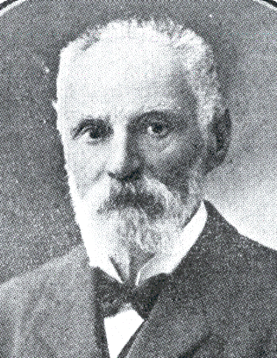
INGUINAL HERNIA : HALL OF FAME
Thomas Annendale of Edinburgh : 1876
Preperitoneal approach to the inguinal-femoral region
Dr. Edward Earle Shouldice (1890-1965),
Edouardo BASSINI (1844-1924)

Slide 4
INGUINAL HERNIA : HALL OF FAME
« MODERN TIME »
1948: AQUAVIVA and BOURRET : first use of a nylon mesh in inguinal hernia repair,
1958: USHER : first use of a polypropylène in inguinal hernia repair,
1974: Lichtenstein : described a « fashioned mesh » in reccurent hernia repair,
1989: Lichtenstein : « tension free hernioplasty »
1987: GILBERT : « plug » for indirect inguinal hernia
1993: RUTKOW: « plug » for « tension free hernioplasty »

Slide 5
Dr. Edward Earle Shouldice (1890-1965),
« Shouldice technique versus other open techniques for inguinal hernia repair »
Amato B and all,
Cochrane Library 2009
Shouldice herniorrhaphy is the best non-mesh technique in terms of recurrence
, though it is more time consuming and needs a slightly longer post-operative hospital stay.
The quality of included studies, assessed with jaded scale, were low. Patients have similar characteristic in the treatment and control group but seems more healthy than in general population, this features may affect the dimension of effect in particularly recurrence rate could be higher in general population.”

Slide 6
« Shouldice technique versus other open techniques for inguinal hernia repair »
Amato B and all,
Cochrane Library 2009
“When Mesh is used, the recurrence rate is reduced by 50%-70% compared to repairs without mesh.”
BUT : « the must commun morbidity has been chronic pain with an important impact on the quality of live »
Inguinodynia
Neuropathic pain : IIN ; IHN ; GFN.
    trauma during dissection
    Retraction of tissues
    Nerve entrapment from post operative fibrosis
    Mesh related fibrosis
    Sutures used to fix the mesh
Non neuropathic pain
    Execive scar formation resulting from mesh reaction
    Rolled-up bulky mesh leading to mechanical pressure
    Periostal reaction from sutures or staples in the pubic bone
    Veinous congestion or mesh related inflammation of the spermatic cord

Slide 7
“Inguinodynia following Lichtenstein tension-free hernia repair: A review
World J Gastroenterol. 2011 April 14; 17(14): 1791–1796.”
The incidence varies among studies, ranging between 0% and 62.9%, with 10% of patients fitting in the moderate to severe pain group.
However, only 2%-4% of the patients are adversely affected by chronic groin pain in their everyday life.
Management of chronic groin pain
  challenging issues for the clinician
  impact on the health system and economy.

Slide 8



Slide 9
TYPE OF MESH AND PAIN
HW vs LW
Two Randomised controled trials with a long follow up
. Bringman S,and all. Br J Surg. 2006;93:1056–1059.
. Paajanen H.. Hernia. 2007;11:335–339.
Bringman et al : RCT 590 patients with 3 year follow-up,
no differences in neuralgic pain, hypoaesthesia or hyperaesthesia.
Significantly more men in the standard mesh group could feel the mesh in the groin: 22.6% vs 14.7%.
no difference in recurrence rates
Paajanen H : single centre RCT on three different composite meshes with a 2 year follow-up : Similar views .

Slide 10

Why not a partially or fully obsorbable mesh?
« To avoid complications, the use of absorbable mesh, such as those made of lactic acid polymer or lactic and glycolic acid copolymers, has been proposed. Regrettably, this exposes the patient to inevitable hernia recurrence because the inflammatory reaction, through a hydrolytic reaction, completely digests the implant prosthetic matérial »

Slide 11
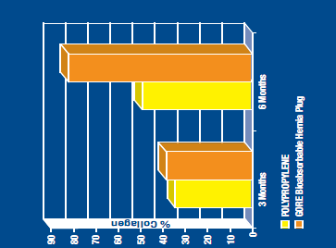
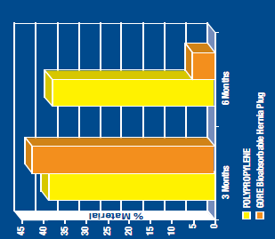
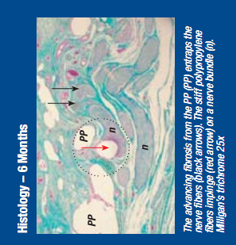
Morales-Conde S, Flores M, Fernandez V, Morales-Mendez S. Bioabsorbable vs polypropylene plug for the “mesh and plug” inguinal hernia repair.
Poster presented at American Hernia Society, February 2005.
Mesh-reinforcement of the abdominal wall
Remodelling of the abdominal wall
MORE COLLAGEN and LESS MATERIAL

Slide 12
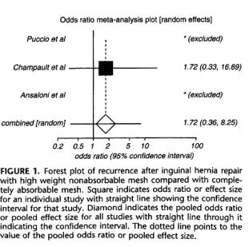
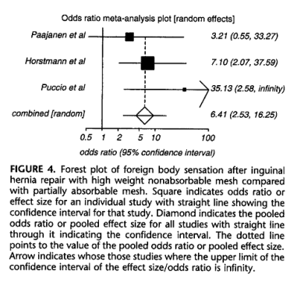
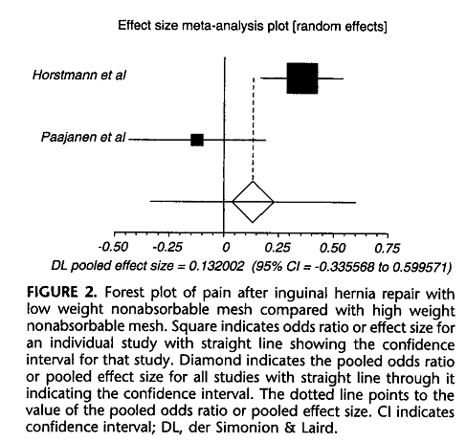
PARTIALLY OR COMPLETELY ABSORBABLE VERSUS NONABSORBABLE MESH REPAIR FOR INGUINAL HERNIA
Markar et All.
Surg. Lap.Andosc. Percutan.Tech. 2010; 20,4 : 213-19.
Foreign body feeling after mesh repair:
  Similar for LW non absorbable (7.2%), partially (7.7%) and totally absorbable (7.4%)
  HW non absorbable : 14.5%
Reccurence after mesh repair :
  Comparable between all groups
  LW and HW nonabsorbable (2.7% and 2.5%)
  Partially absorbable (3.4%)
  Completely absorbable (1.5%)
Chronic pain after mesh repair:
  5.8% patients with partially absorbable mesh
  4.2% of patients with totally absorbable mesh
  Compared with 2.7% with LW and 11.8% with HW non absorbabe

Slide 13
PARTIALLY OR COMPLETELY ABSORBABLE VERSUS NONABSORBABLE MESH REPAIR FOR INGUINAL HERNIA
Markar et All.
Surg. Lap.Andosc. Percutan.Tech. 2010; 20,4 : 213-19.
Conclusion 1 : « The weight per surface area of the mesh is the most important factor in determining prolonged pain and foreign body sensation in the groin after mesh repair of an inguinal hernia. »
Conclusion 2 : « But from the evidence that is currently available it seems that it is the weight of meshes and not their bioreactivity which has the greatest influence on long-term complications after mesh inguinal hernia repair. »

Slide 14
WHAT CAN WE DO WITH THE CURRENT MATERIEL ?
‘‘Sports’ hernia: treatment with biologic mesh (Surgisis) A preliminary study
D.S.Edelman,H.Selesnick
Surg Endosc(2006)20:971–973
young poeple and athletes as patients with an inguinal hernia.
Those patients are young, healthy, have no medical hillnesses, and heal relatively well.
The mechanism of groin hernia in such population can be du to overuse and not a defect in collagen.
« Then placing a biological material that ollows the young athletic patient to heal makes theorical sense »

Slide 15
DO WE ALREADY HAVE THE IDEAL MESH FOR INGUINAL HERNIA REPAIR?
Is LW non absorbable mesh the « gold standart » ?
Is a totally absorbable mesh the « ideal mesh »?
The « perfect » mesh for all patients:
Low weighted
Low weighted with a « collagen » layer
Low weighted, « collagen » layer and laparoscopy compatible
Low weighted, « collagen » layer , laparoscopy compatible and … economy

Slide 16
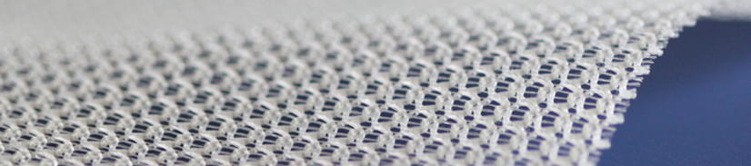
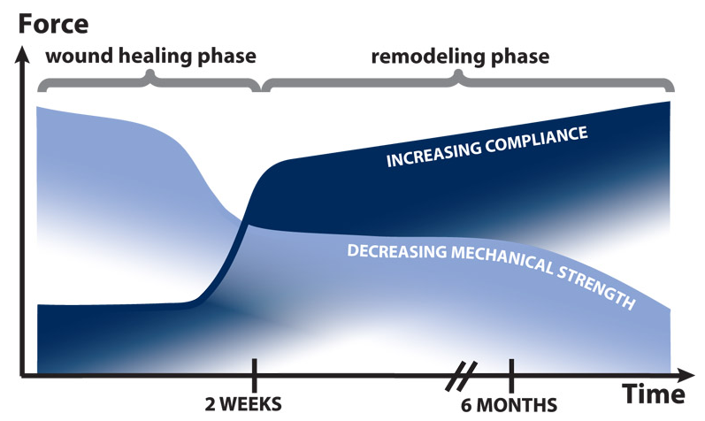
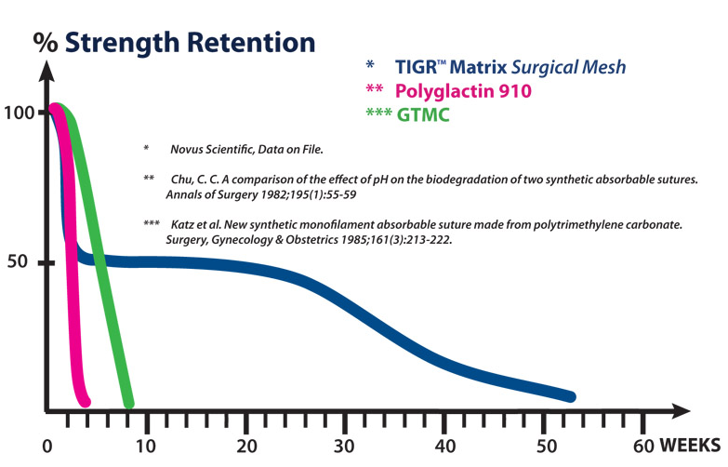
The Next step…
The ideal mesh ???
The first fiber is a copolymer of glycolide, lactide and trimethylene carbonate. The second fiber is a copolymer of lactide and trimethylene carbonate.
Both fibers degrade by bulk hydrolysis once implanted.

Slide 17


Limitation of the literature?
The currently available literature on mesh in inguinal hernia repair is heterogeneous
      A meta analysis is limited because of the impossibility to stratify the mesh group by choise of operative technique, owing to limitation in number.
      Collagen implants : experimental studies are good, but observation periods are short. Clinical data are very heterogeneous.
Group of French surgeons focused in hernia repair:
French register of inguinal hernia repair : started 5 of september 2011

Slide 18
TAKE HOME MESSAGE
INGUINAL HERNIA REPAIR = MESH
CHOISE OF THE MESH : LW non absorbable
  No interrest of absorbable mesh type Vycril®
  Exact place of biomesh in inguinal hernia repair???
ABSORBABLE TRIMETHYLENE CARBONATE : we are waiting for the studies

Slide 19
« No disease of the human body belonging to the province of the surgeon requires in its treatment a greater combination of accurate anatomical knowledge with surgical skill than hernia in all its varieties »
Sir Astley Cooper (1827)

Slide 20
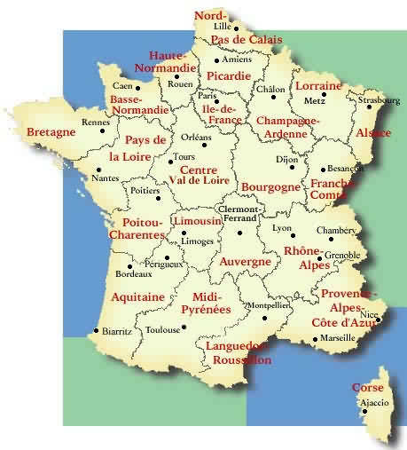



THANK YOU FOR ATTENTION

